Slide 1
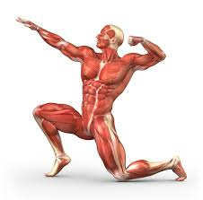
Muscles

Slide 2
Muscular System
Function
Movement
Posture
Support
Maintain body temperature

Slide 3
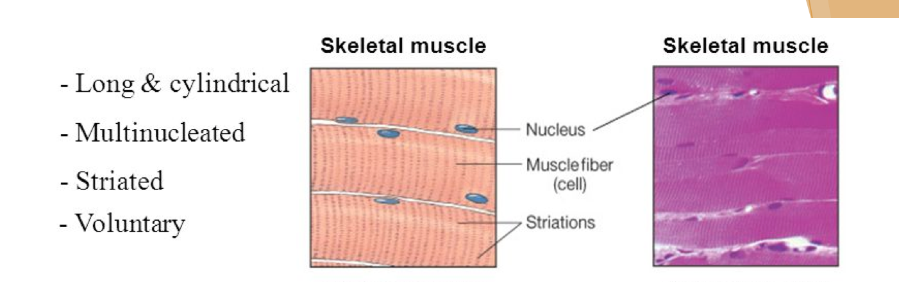

Slide 4
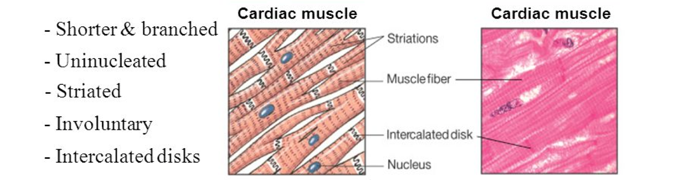

Slide 5
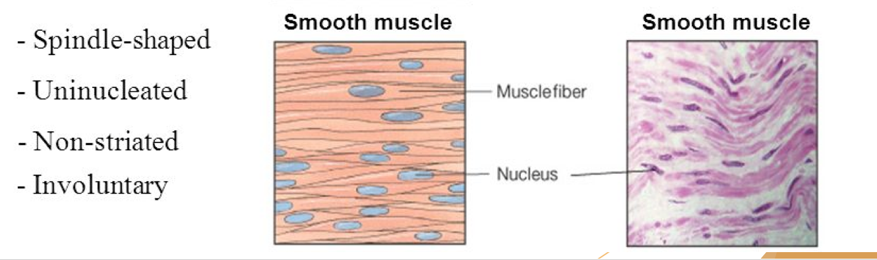

Slide 6
Major Skeletal muscles

Slide 7
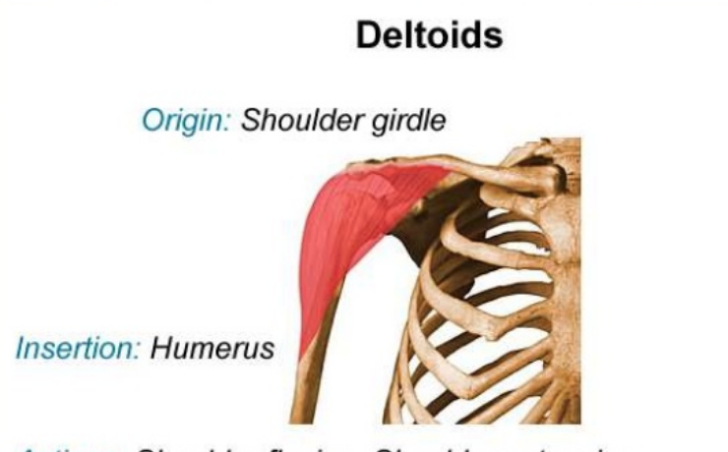

Slide 8
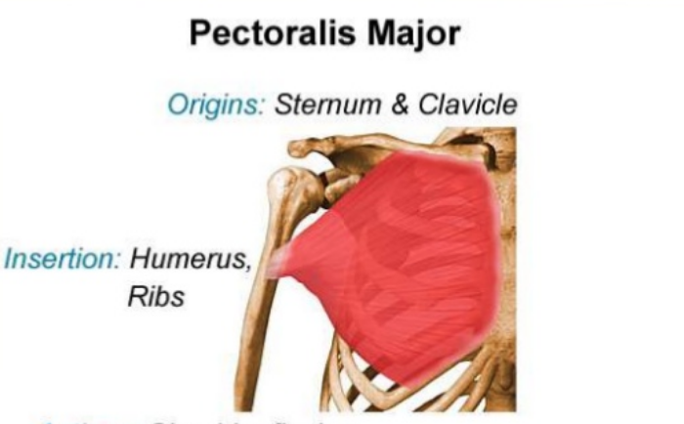

Slide 9
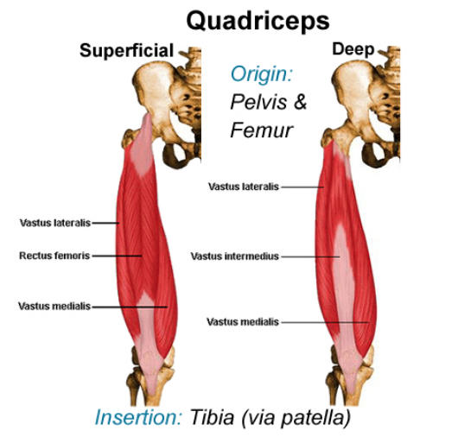

Slide 10
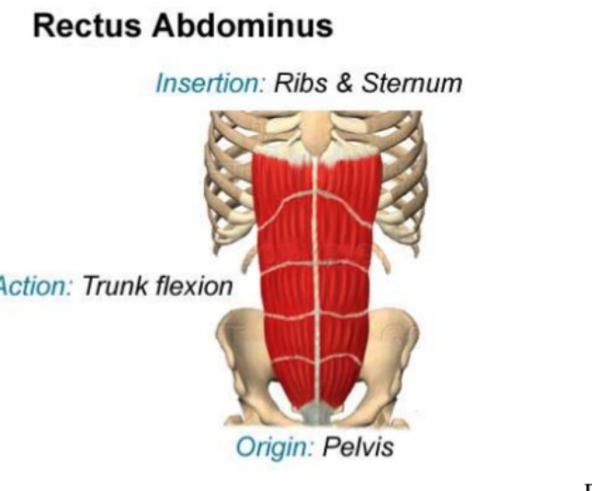

Slide 11
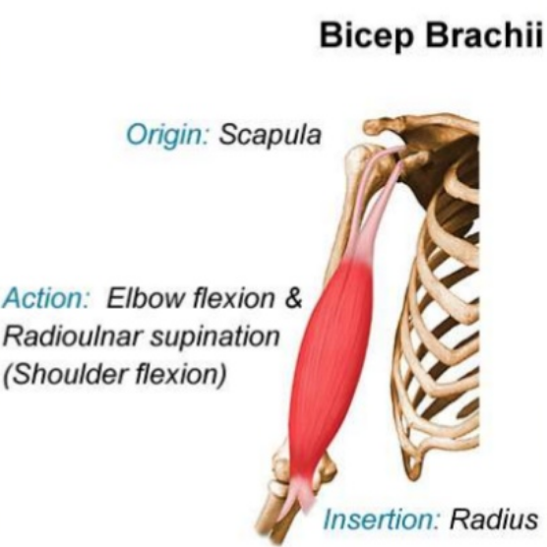

Slide 12
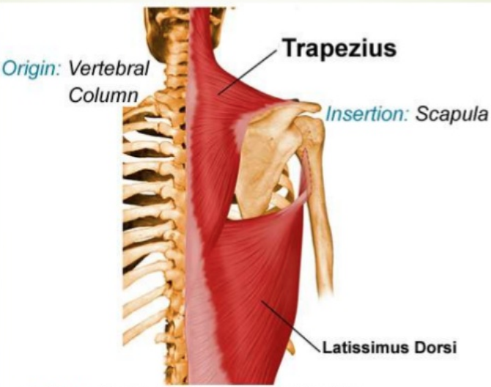

Slide 13
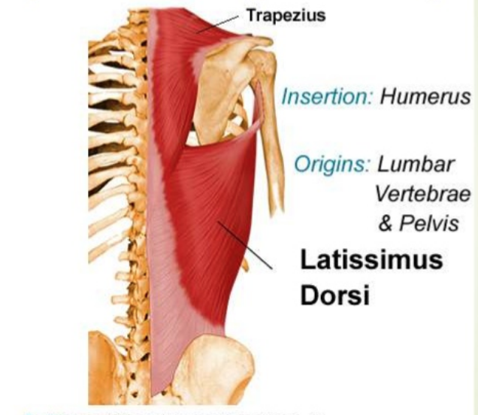

Slide 14
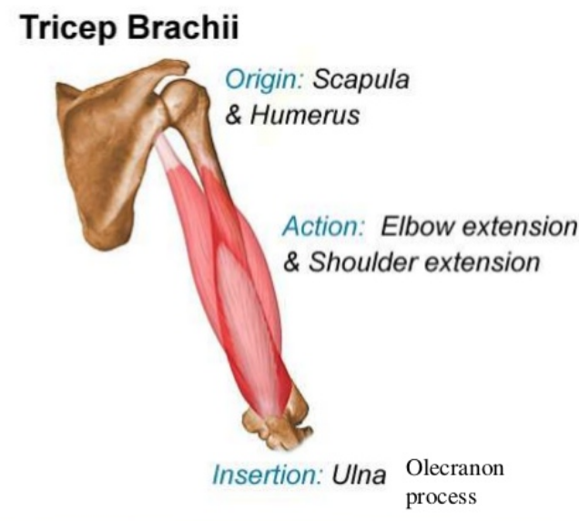

Slide 16
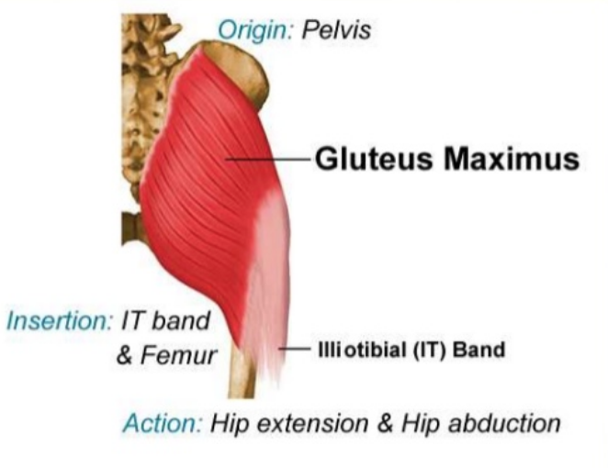

Slide 17
Terms to review:

Slide 18
Muscles:
Anatomical terms
flexion-extension abduction-adduction
rotation-circumduction

Slide 19
flexion-extension

Slide 20
abduction-adduction

Slide 21
rotation-circumduction

Slide 22
The skeletal and muscular system working together
MUSCLE ACTION IN MOVEMENT
All muscles have the ability to contract (shorten) but they also possess extensibility and elasticity. Extensibility is the ability to be stretched, while elasticity is the ability to return to the original length after being stretched. It is these 3 properties that allow for coordinated movement.
DEFINE CONTRACT, EXTENSIBILITY AND ELASTICITY

Slide 23
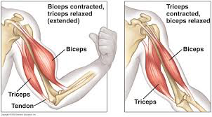
Muscles that work together
The coordinated movement of pairs of muscles are called antagonistic pairs. One muscle will move a bone in one direction. The other muscle will move the bone in the opposite direction.
Examples of antagonistic pairs of muscles are found in the arm and leg.
DEFINE: ANTAGONISTIC
PAIR
Notes:
Define: antagonistic pairs of muscles, origin, insertion, agonist, antagonist, synergists

Slide 24
Antagonistic pair: pair of muscles cause movement. Cause bones to move in opposite directions.
e.g. found in arm and leg

Slide 25
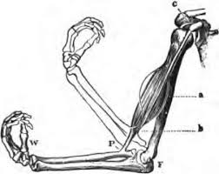
Muscles that work together
The origin where the muscle is attached to a stationary bone.
The insertion is where the muscle is attached to the moving bone.
DEFINE: ORIGIN AND INSERTION
Notes:
Define: antagonistic pairs of muscles, origin, insertion, agonist, antagonist, synergists

Slide 26
Muscles that work together
Which bone is moving?
C and P are the point
where the
muscles attach.
Which is the
origin
and insertion?
Notes:
Define: antagonistic pairs of muscles, origin, insertion, agonist, antagonist, synergists

Slide 27
Muscles that work together
The muscle that causes the movement is called the agonist.
The muscle that has the opposite effect is called the antagonist.
DEFINE: AGONIST AND ANTAGONIST
Notes:
Define: antagonistic pairs of muscles, origin, insertion, agonist, antagonist, synergists

Slide 28
Muscles that work together
Image 1: the arm is flexing
due to the biceps
moving it. The biceps is
the agonist. The triceps
the antagonist.
Image 2:????
Notes:
Define: antagonistic pairs of muscles, origin, insertion, agonist, antagonist, synergists

Slide 29
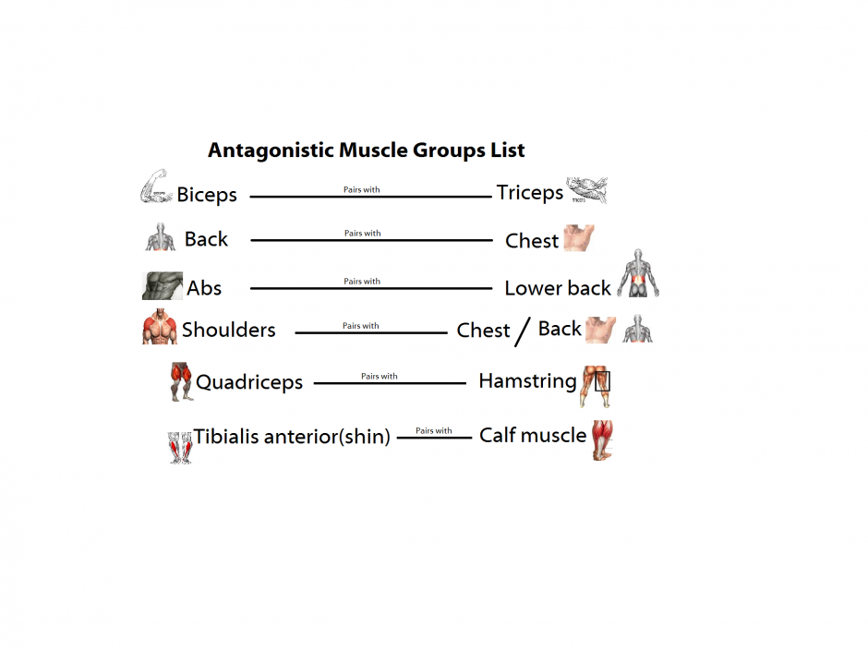

Slide 30
How we walk activity
Step one: SLOWLY walk around the room. As you do identify all the leg muscles you are using.
Notes:
Define: antagonistic pairs of muscles, origin, insertion, agonist, antagonist, synergists

Slide 31
How we walk activity
Step one: SLOWLY walk around the room. As you do identify all the leg muscles you are using.
Step two: Slowly lift your right leg off the floor. Which muscle pull your leg up?
Notes:
Define: antagonistic pairs of muscles, origin, insertion, agonist, antagonist, synergists

Slide 32
How we walk activity
Step one: SLOWLY walk around the room. As you do identify all the leg muscles you are using.
Step two: Slowly lift your right leg off the floor. Which muscle pull your leg up?
Step three: slowly lift your heel off the floor. Which muscle pulls it off the floor?
Notes:
Define: antagonistic pairs of muscles, origin, insertion, agonist, antagonist, synergists

Slide 33
How we walk activity
Step one: SLOWLY walk around the room. As you do identify all the leg muscles you are using.
Step two: Slowly lift your right leg off the floor. Which muscle pull your leg up?
Step three: Slowly lift your heel off the floor. Which muscle pulls it off the floor?
Step four: Slowly move your leg forward. Which muscle moves your leg forward?
Notes:
Define: antagonistic pairs of muscles, origin, insertion, agonist, antagonist, synergists

Slide 34
How we walk – How we have locomotion
Hamstring contracts
Lifts leg at knee (flexion)
Calf contracts
Lifts heel off floor
Quadricep contracts
Leg out in front (extension)
Notes:
Define: antagonistic pairs of muscles, origin, insertion, agonist, antagonist, synergists

Slide 35
How we walk – How we have locomotion
As we walk our arms swing back and forth.
WHY?
Notes:
Define: antagonistic pairs of muscles, origin, insertion, agonist, antagonist, synergists

Slide 36
How we walk – How we have locomotion
As we walk our arms swing back and forth.
Our arms swing back and forth to offer stability and counter act the forward motion on one side.
E.g. Right leg forward ----with----- left arm forward.
Notes:
Define: antagonistic pairs of muscles, origin, insertion, agonist, antagonist, synergists

Slide 37
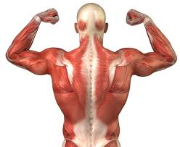
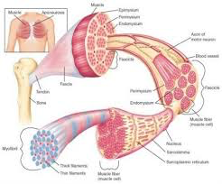
Structure of Muscles
Notes:
Fill in the blank

Slide 38
Structure of Muscles
Actin (thin) and myosin (thick) are the two types of myofilaments that form a sarcomere.
Notes:
Fill in the blank

Slide 39
Structure of Muscles
Sarcomeres are found within small cable-like structures called Myofibrils combine to make a single Muscle Fibre (muscle cell).
Notes:
Fill in the blank

Slide 40
Structure of Muscles
Muscle fibers are very long cable-like cells which bundle together to form a Muscle Bundle or Fascicle. A group of fascicles makes a Muscle.
Notes:
Fill in the blank

Slide 41
Actin (thin) and myosin (thick) are the two types of myofilaments that form a sarcomere. Sarcomere are found within small cable-like structures called Myofibrils combine to make a single Muscle Fibre (muscle cell). Muscle fibers are very long cable-like cells which bundle together to form a Muscle Bundle or Fascicle. A group of fascicles makes a Muscle.
Structure of Muscles
Notes:
Fill in the blank

Slide 42
Structure of Muscles
Actin (thin) and myosin (thick) = 2 myofilaments
Sarcomere
Myofibril
muscle fibre (muscle cell)
muscle bundle (fascicle)
muscle.
Notes:
Fill in the blank

Slide 43
Sliding Filament Model
Notes:
Fill in the blank

